Slide 1
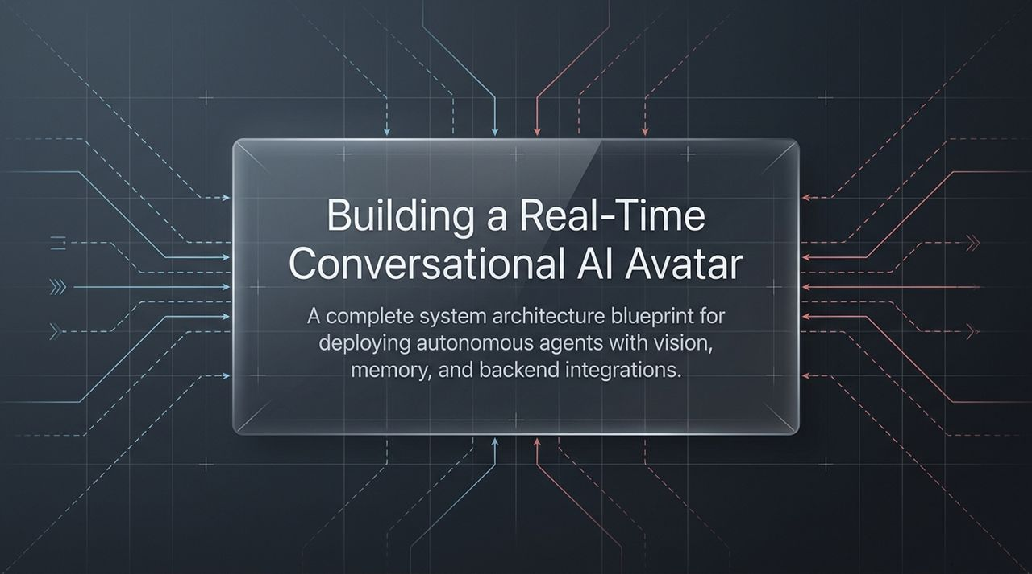
Notes:
Welcome, everyone. Today, we are walking through a full system architecture blueprint for building a real-time, interactive AI avatar.
When people hear 'AI Avatar,' they often picture simple text-to-speech rendering mapped to a lip-synced face. What we are showcasing today goes far beyond static video generation.
We are discussing an autonomous agent capable of visual context processing, continuous session memory, dynamic retrieval-augmented generation (RAG), and bidirectional REST API communications—all delivered in sub-second streaming latency directly inside the browser.
By orchestrating real-time audio/video streaming via WebRTC with modern state-machine logic, we allow users to hold seamless, human-like voice conversations while the AI observes, diagnoses, and acts.
https://www.youtube.com/watch?v=CyMIar4TDhw

Slide 2
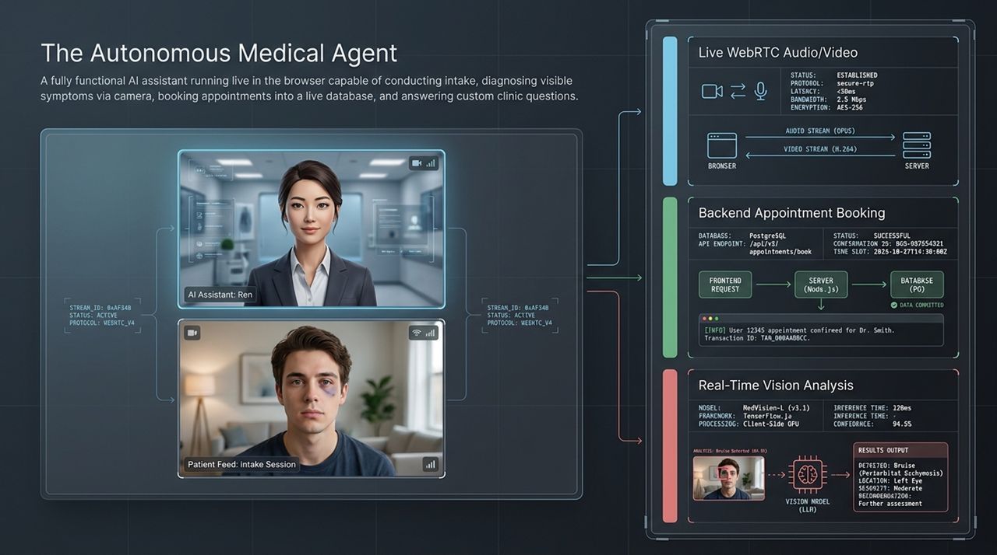
Notes:
To understand the architecture, let’s examine our live case study: an Autonomous Medical Screening Assistant running natively in a Next.js client.
In this scenario, a patient joins a secure WebRTC video room. On screen, the user interacts with 'Ren,' an AI avatar.
The system executes four core tasks sequentially:
Conversational Patient Intake: Gathering patient identity and chief complaints via natural spoken conversation.
Computer Vision Diagnosis: The avatar inspects physical symptoms—such as facial swelling or a bruise under the eye—directly through the user’s webcam stream.
Transactional Database Writing: Interacting with a PostgreSQL database via REST APIs to check available schedule slots and execute appointment bookings.
Strict RAG-Grounded QA: Answering operational clinic questions using verified markdown documents.
Notice the real-time telemetry: Opus audio streams, H.264 video streams, client-side TensorFlow.js vision inference, and server-side transaction logging.

Slide 3
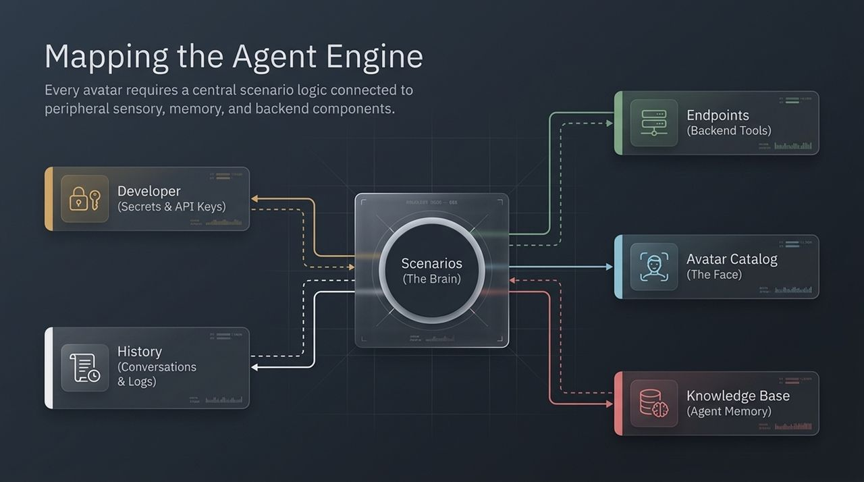
Notes:
At the core of the Aapulu platform sits the Agent Engine, structured cleanly into central logic and peripheral capabilities.
Think of the Scenarios Hub as the 'Brain'. It controls node-based state flow, turn-taking, and decision boundaries.
Surrounding the Brain are five peripheral modules:
Developer Portal: Holds authentication keys and secret variables to safeguard backend infrastructure.
History & Logs: Provides full session playback, structured JSON interaction transcripts, and usage metrics.
Knowledge Base (Agent Memory): Vector/Markdown RAG store containing domain facts.
Avatar Catalog (The Face): Photorealistic visual representations mapped directly to audio output streams.
Endpoints (Backend Tools): Webhooks and REST integrations connecting the LLM to external business logic.

Slide 4
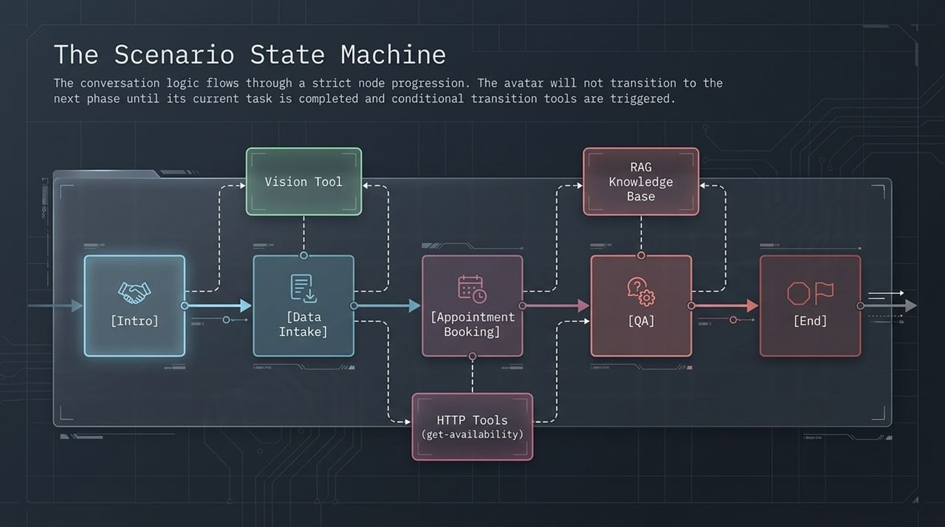
Notes:
A common point of failure in conversational AI is using open-ended prompt loops. Unstructured prompts easily wander off-topic or execute actions out of order.
To solve this, we enforce a Finite State Machine architecture. Conversation logic flows sequentially through explicit nodes: [Intro] $→$[Data Intake] $→$[Appointment Booking] $→$[QA] $→$[End].
Key rules governing node transitions:
An agent cannot jump to booking until intake criteria are fulfilled.
Transitions occur only when conditional tool triggers are explicitly called by the model.
Tools are bound locally to specific nodes. For example, the Vision Tool is only accessible during [Data Intake], while RAG execution is restricted to [QA].

Slide 5
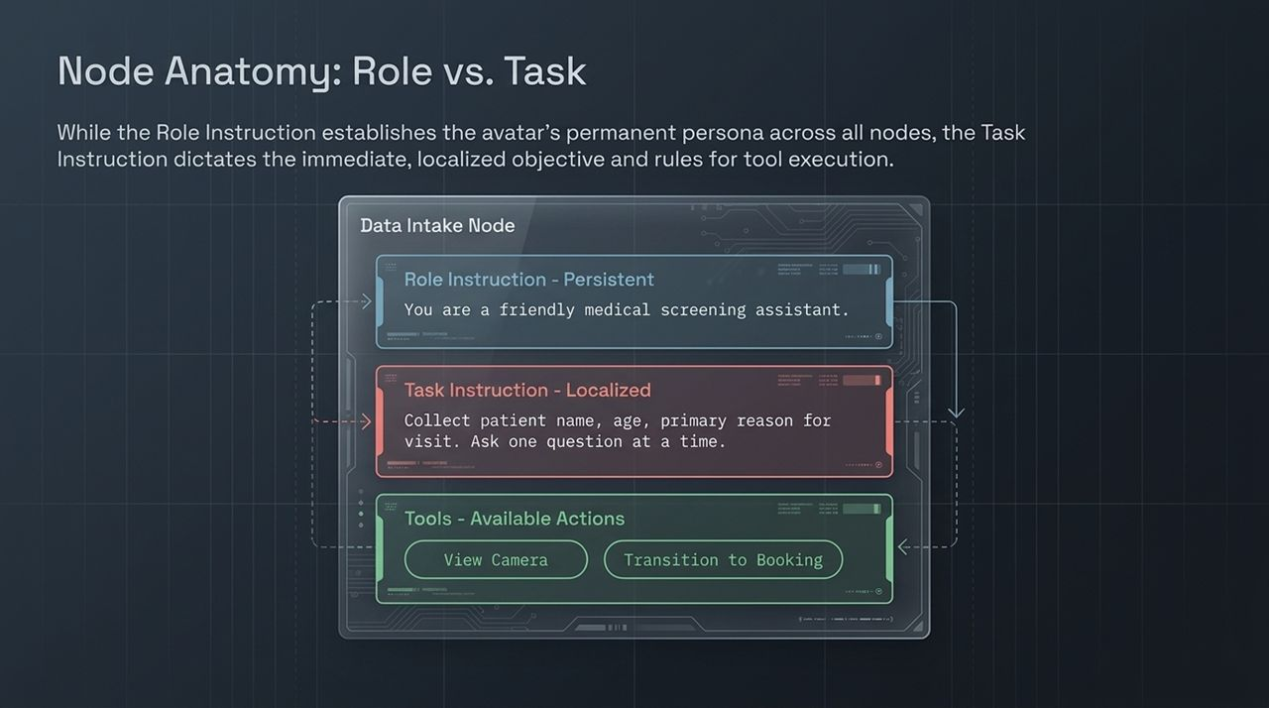
Notes:
To maintain behavioral stability across multi-turn interactions, every node separates system directives into two prompt tiers: Persistent Roles and Localized Tasks.
1. Role Instruction (Persistent): Set at the top tier of the scenario. Defines identity, persona, tone, and speech conversion constraints (e.g., 'You are a friendly medical assistant. Keep responses concise for text-to-speech output').
2. Task Instruction (Localized): Unique to the active node. Defines the immediate operational target (e.g., 'Collect full name, age, and chief complaint. Ask one question at a time').
3. Scoped Actions: Binds executable tool functions directly to the active step.

Slide 6
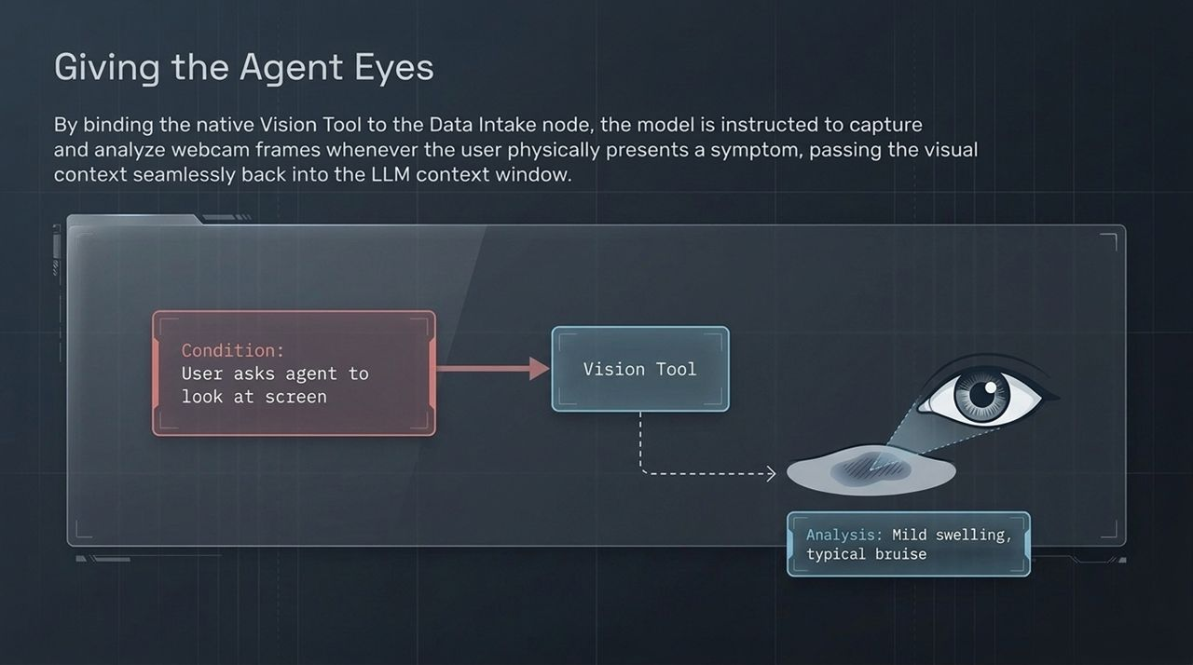
Notes:
Adding visual perception to an avatar transforms it from a voice-only bot into a true clinical assistant.
In our architecture, visual processing is added as a native tool (view_camera) bound to the Data Intake node.
How it works in practice:
The user visually references a physical issue (e.g., 'Can you check this bruise under my eye?').
The LLM identifies the intent and invokes view_camera.
The frontend client captures the webcam frame, processes visual feature vectors, and feeds the image payload back into the model's active context window.
The agent immediately returns visual findings: identifying mild swelling and periorbital ecchymosis, offering care advice, and continuing intake without breaking conversational momentum.

Slide 7
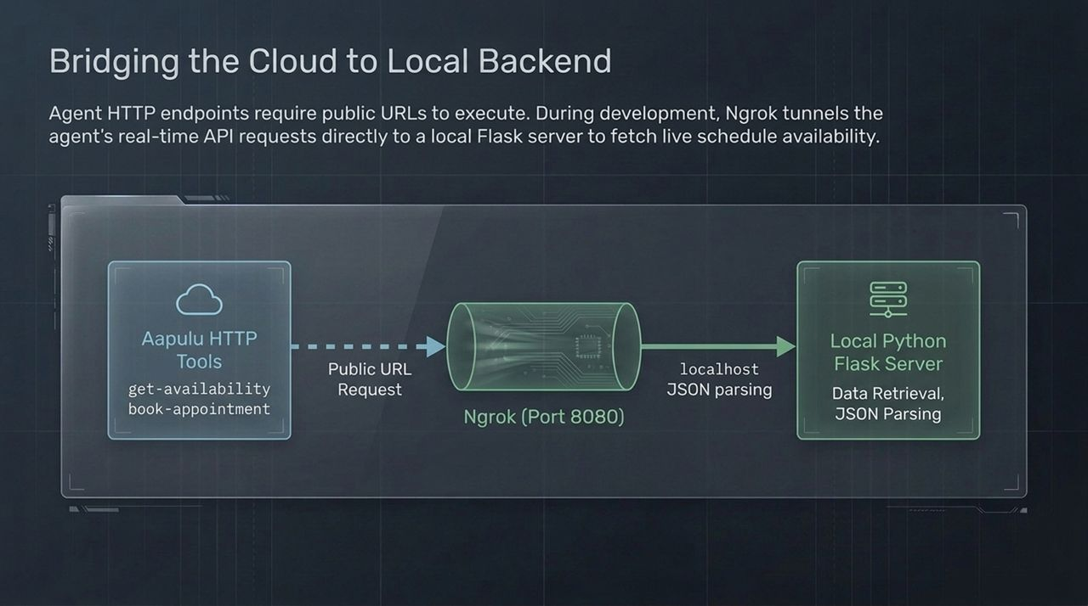
Notes:
When building real-world AI applications, cloud engines must interact with enterprise API endpoints.
During development, your API backend—such as our Python Flask server handling scheduling logic—runs on localhost:8080.
Because cloud platform webhooks require publicly accessible HTTPS URLs, we use Ngrok tunneling:
Cloud HTTP Tools issue webhook calls over public HTTPS.
Ngrok routes traffic securely through tunnel port 8080 into our local Python server.
The Flask app parses incoming JSON payloads, executes local database operations, and returns JSON back to the agent.

Slide 8
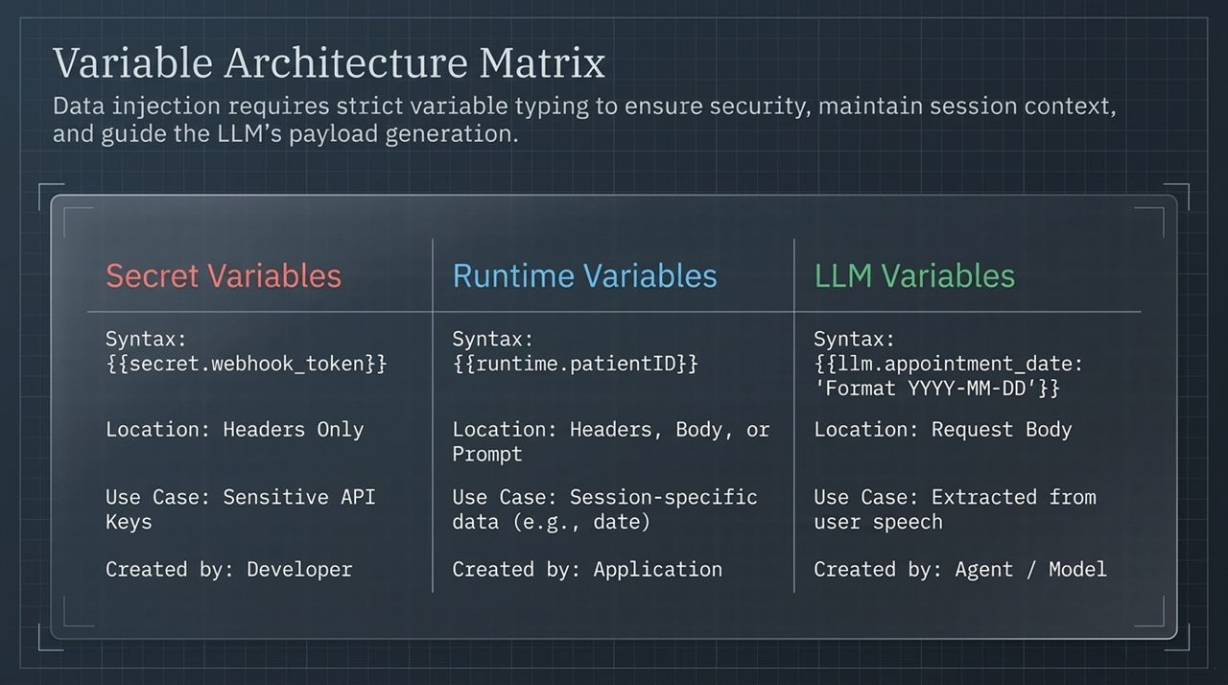
Notes:
Data management in an AI system requires strict isolation between system credentials, session state, and dynamic model outputs.
We implement a strict Three-Tier Variable Matrix:
Secret Variables ({{secret.token}}):
Purpose: Authentication tokens and API keys.
Rule: Restricted strictly to HTTP request headers. Never allowed in the request body, preventing leakage into conversation transcripts or client logs.
Runtime Variables ({{runtime.patientID}}):
Purpose: Session context injected programmatically by the client app at connection startup (e.g., patient IDs, current system date).
LLM Variables ({{llm.appointment_date}}):
Purpose: Dynamic arguments populated by the LLM during tool calls.
Requirement: Must include formatted inline syntax constraints (e.g., 'Format YYYY-MM-DD') to enforce valid schema generation.

Slide 9
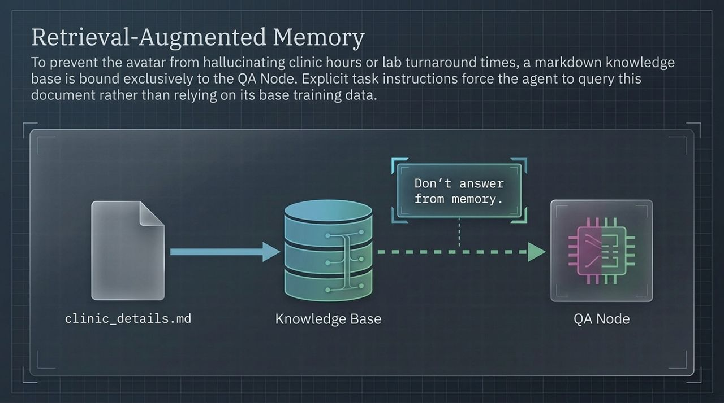
Notes:
One of the greatest liabilities in conversational systems is hallucinated advice—such as quoting incorrect clinic hours or lab result turnaround times.
In Slide 9, we isolate knowledge access directly within our QA Node using target-bound Retrieval-Augmented Generation.
Rather than bloating base prompts with static facts, we upload external documentation (e.g., clinic_details.md) to a knowledge store.
We enforce a negative constraint in the task prompt: 'Use the clinic RAG tool for all facility queries. Do NOT answer from internal base training memory.'
When a patient asks about lab turnaround times, the agent retrieves verified markdown entries (e.g., 2–4 days for routine labs) and summarizes them accurately.

Slide 10
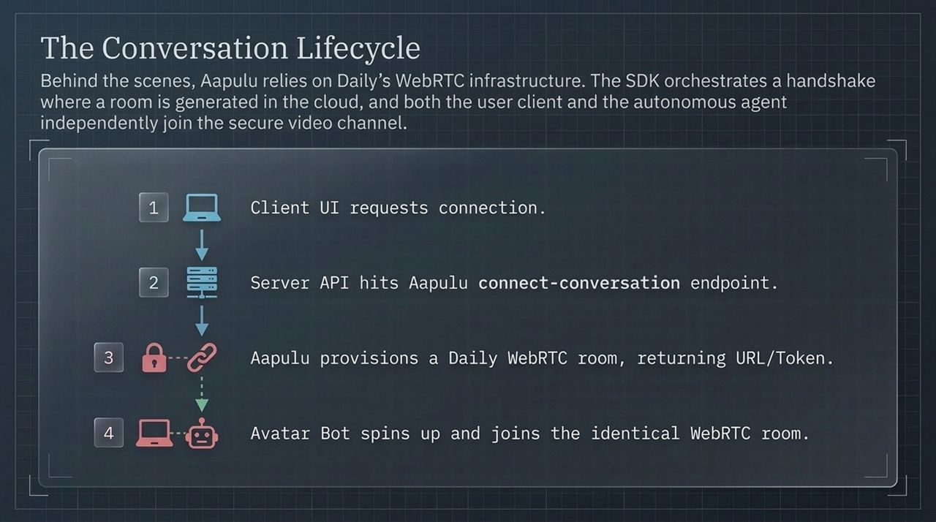
Notes:
Let's examine what happens under the hood during connection initialization.
The application leverages Daily WebRTC infrastructure for real-time media transport. The initialization sequence follows 4 distinct steps:
Client Request: The Next.js frontend initiates a request to start a conversation.
Server Handshake: The application server calls the Aapulu cloud server client via secure API key.
Room Provisioning: Aapulu provisions a secure Daily WebRTC media room and generates an access token.
Dual-Agent Join: The returned room URL and token allow both the user client and the autonomous avatar bot to enter the video call room simultaneously as equal peer nodes.

Slide 11
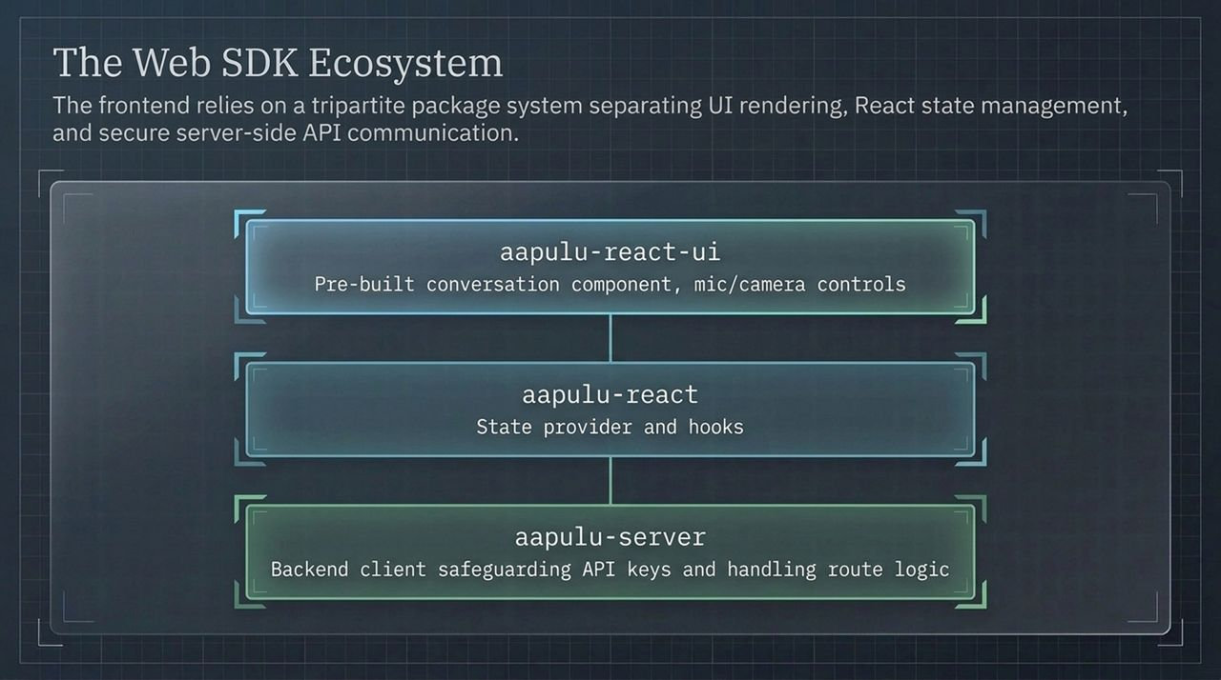
Notes:
Implementing real-time AI inside web applications is made simple using three dedicated SDK packages:
aapulu-react-ui: Provides pre-built React components, offering out-of-the-box video frames, live transcript views, and mic/camera controls.
aapulu-react: The core state engine, providing React providers (AapuluProvider) and hooks to track conversation states, network health, and room activity.
aapulu-server: Running exclusively on node/server environments to securely manage secret API keys and handle token generation endpoints.

Slide 12
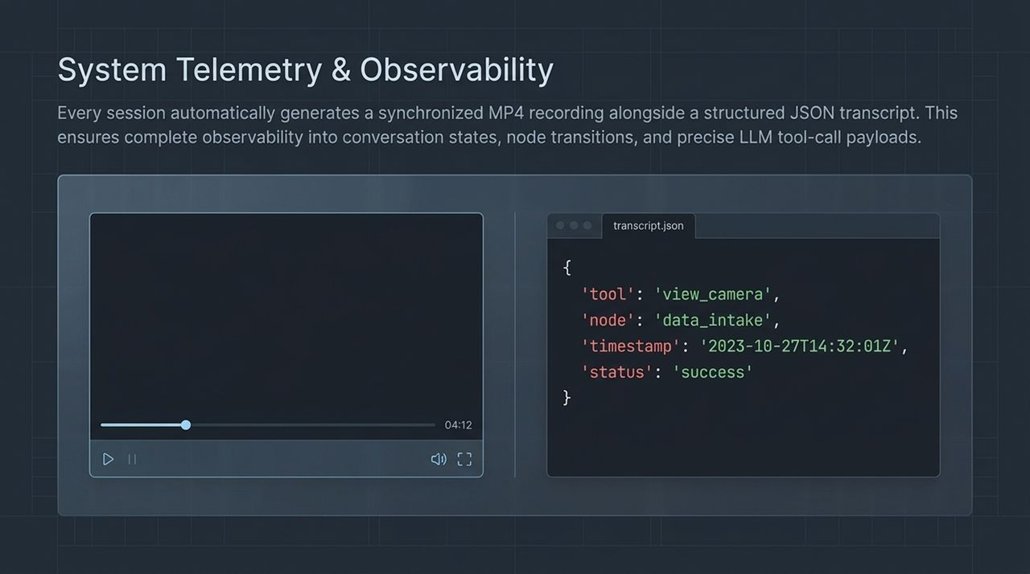
Notes:
For healthcare and enterprise deployments, full observability into AI behavior is non-negotiable.
Every completed session generates dual diagnostic artifacts:
Synchronized MP4 Recording: Captures visual feed, synthetic avatar voice, and user audio streams for QA auditing.
Structured JSON Telemetry Log: Records step-by-step state machine movements, precise timestamps, LLM payload parameters, and webhook call statuses.
If an integration fails or an unexpected node transition occurs, developers can inspect exact JSON parameter states to diagnose issues immediately.

Slide 13
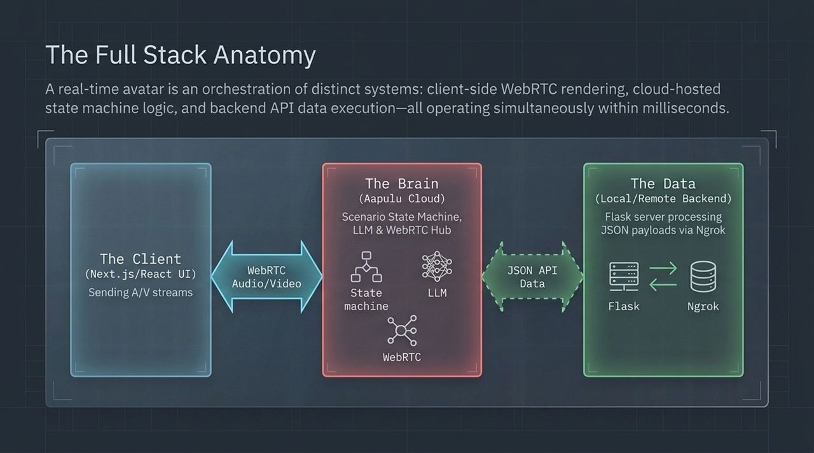
Notes:
Slide 13 brings the complete architecture together into three synchronized operational tiers:
The Client Tier (Next.js/React UI): Handles local video rendering, webcam sampling, and client WebRTC streaming.
The Brain Tier (Aapulu Cloud Engine): Orchestrates the state machine, routes prompts to multimodal LLMs, manages speech-to-text / text-to-speech pipelines, and serves as the WebRTC hub.
The Data Tier (Enterprise Backend): Your custom databases, REST servers, and API systems running behind secure webhooks.
These three systems communicate in real time, transforming static models into responsive visual agents.

Slide 14
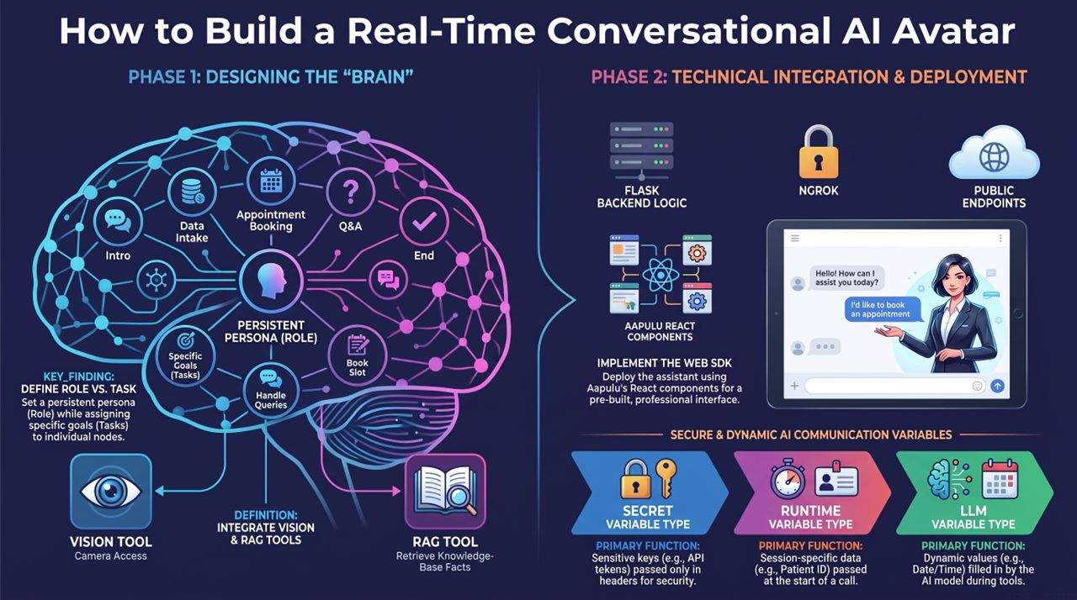
Notes:
To wrap up our architecture presentation, let's review our master deployment workflow across two phases:
Phase 1: Designing the Brain
Map explicit conversation flows into state nodes.
Separate global Role personas from node-bound Task prompts.
Bind multi-modal tools—such as vision sampling and knowledge base RAG lookup—to specific conversation stages.
Phase 2: Technical Integration & Deployment
Define public REST endpoints and configure strict variable typing (secret, runtime, llm).
Expose local backends using Ngrok tunnels during development before pushing to cloud servers.
Implement front-end interfaces using React UI SDK components.
Thank you for your time, and we look forward to seeing the autonomous agents you build with this architecture!

